Slide 1

Classification of Brain MRI Using Multi Bit Planes
Team Details
Team Number: B4
Sl.Num. | Student Name | USN | Roll Num. | Division
1 | Arfaahussain Shaikh | 01FE21BCS008 | 202 | B
2 | Naveenkumar B | 01FE21BCS051 | 210 | B
3 | Gourish Pattanshetti | 01FE21BCS025 | 265 | B
4 | Bharat Muragundi | 01FE21BCS164 | 426 | D
Guide: Prof. Vishwanath P Baligar

Slide 2

Introduction
This project initiates the exploration of advanced imaging techniques for the classification of brain MRI images. The central focus involves developing a model capable of accurately categorizing these images into predefined classes, such as no tumor, glioma tumor, meningioma tumor and pitutary tumor. Ensuring the versatility of the model is a primary objective, with the intention of its application across diverse MRI datasets. The project emphasizes the critical role of precision in medical diagnostics, striving for high accuracy in the classification of brain MRI images. Through the utilization of multi-bit plane methods, this initiative contributes to the ongoing advancements in medical imaging technology, potentially resulting in enhanced patient outcomes and a transformative impact on the field of medical diagnostics.

Slide 3
Problem Statement
To develop a model that classifies brain tumor based on brain MRI images using multi-bit planes.

Slide 4
Objectives
To Develop a machine learning model to classify Brain MRI images into predefined categories, such as normal,no tumor.
Create a model that can be applied to various MRI datasets.
Achieve high precision in classifying Brain MRI images.

Slide 5
Literature Survey:
1. Segmentation, Feature Extraction, and Multiclass Brain Tumor Classification
Problem Statement:
Brain tumors are difficult to classify due to their heterogeneous. As a result, radiologists have difficulty accurately predicting brain tumors.
Methodology:
Segmenting the tumor regions using a content-based active contour model (CBAC).
Extracting 218 intensity and texture features from the segmented regions of interest (SROIs).
Objectives:
The propose a system for authors to assist radiologists in multiclass brain tumor classification.
Results:
The proposed method achieved an overall accuracy of 85.23% for six-class classification.
Conclusion:
The authors conclude that the proposed CAD system is a promising tool for assisting radiologists in the diagnosis of brain tumors.

Slide 6
Literature Survey:
2. feature extraction using DWT and probabilistic neural network
Problem Statement:
Accurately identifying and classifying brain tumors from MRI images is challenging due to the complex nature of tumors and variations in MRI scans.
Methodology:
Preprocessing the MRI images to remove noise and enhance features.
Preprocessing the MRI images to remove noise and enhance features.
Objectives:
Develop a method using Discrete Wavelet Transform (DWT) and Probabilistic Neural Networks (PNN).
To improve the accuracy of brain tumor identification and classification in MRI images.
Results:
The proposed method achieved nearly 98% accuracy in identifying normal and abnormal tissues in MRI images.
Conclusion:
The authors demonstrated that their method using DWT and PNN is a promising approach for accurate brain tumor identification and classification in MRI images.

Slide 7
Literature Survey:
3. Classification using hybrid Deep CNN with LuNet Classifier
Problem Statement:
Early diagnosis of brain tumors is challenging due to the difficulty of segmenting and classifying them accurately.
Methodology:
The proposed approach uses a hybrid deep convolutional neural network with a LuNet classifier to segment and classify brain tumors.
Objectives:
The article proposes a hybrid deep convolutional neural network with a LuNet classifier to improve the accuracy of brain tumor segmentation.
Results:
The proposed method achieved an accuracy of 99.7%, outperforming other existing algorithms.
Conclusion:
The hybrid deep convolutional neural network with a LuNet classifier is a promising approach for accurate brain tumor segmentation and classification.

Slide 8
Literature Survey:
4. Classified Using a Low-Complexity Neural Network
Problem Statement:
Brain tumor detection is challenging due to the difficulty of differentiating tumors from healthy tissue.
Methodology:
The authors develop a new CNN architecture with features specifically designed for brain tumor detection.
Objectives:
The article proposes a new convolutional neural network (CNN) model for accurate brain tumor detection with low computational complexity.
Results:
The new CNN model achieved high accuracy in brain tumor detection, comparable and being significantly faster and more computationally efficient.
Conclusion:
The proposed low-complexity CNN is a promising approach for accurate and efficient brain tumor detection.

Slide 9
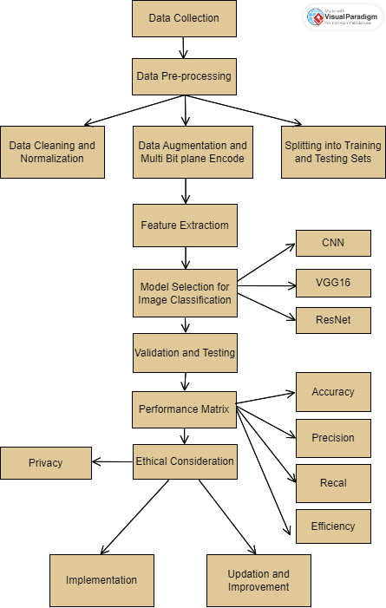
Description of the proposed system with a simple block diagram

Slide 10
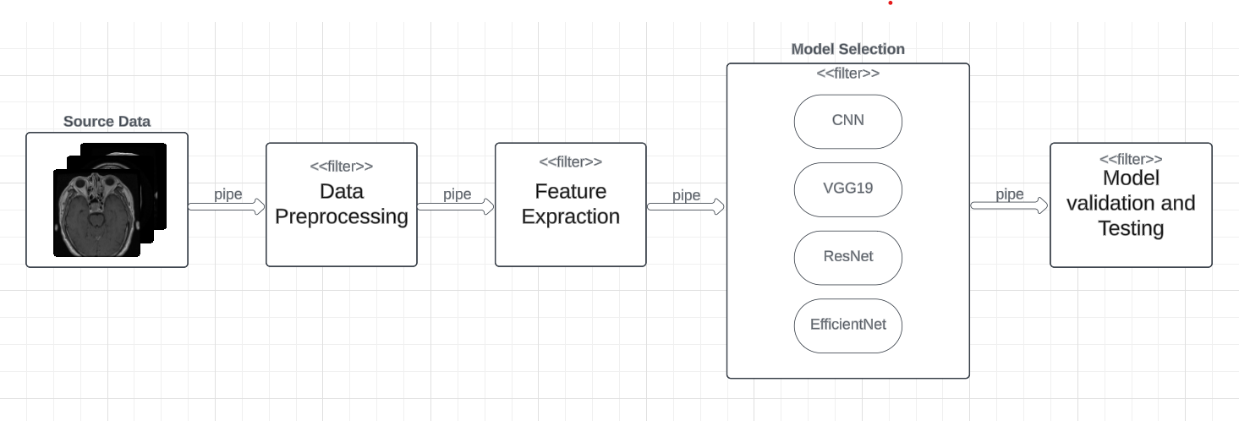
High-Level Design
Pipe-filter Architecture

Slide 11
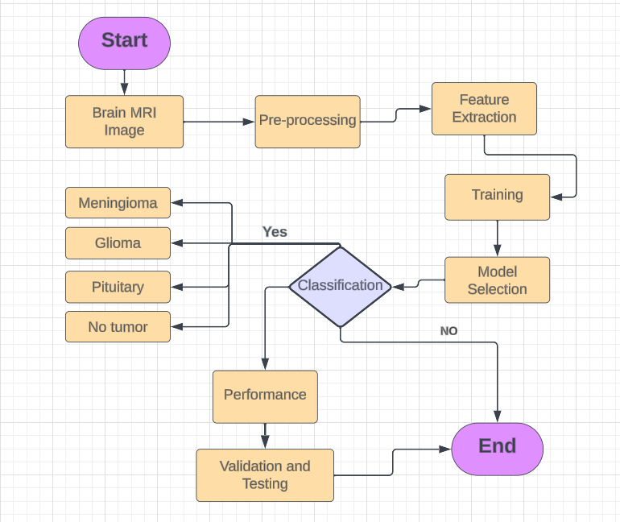
Detailed Design
Flow chart

Slide 12
Implementation
Modules implemented
CNN
VGG19
Efficient Net
Resnet

Slide 13
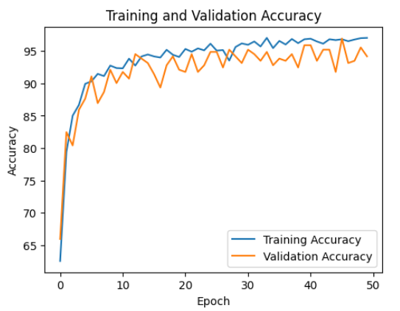
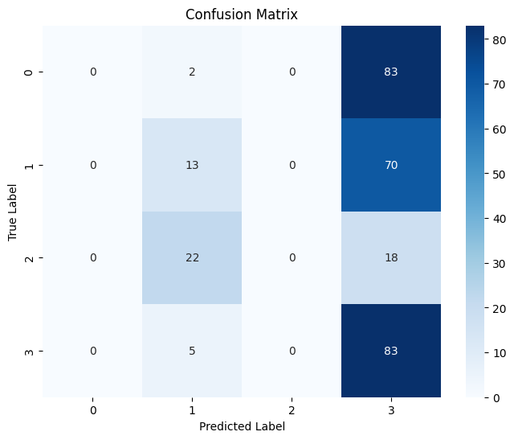
Results
1. CNN

Slide 14

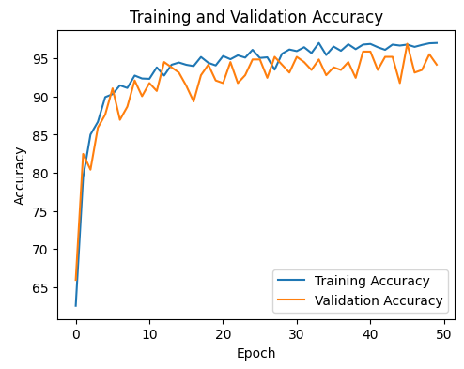
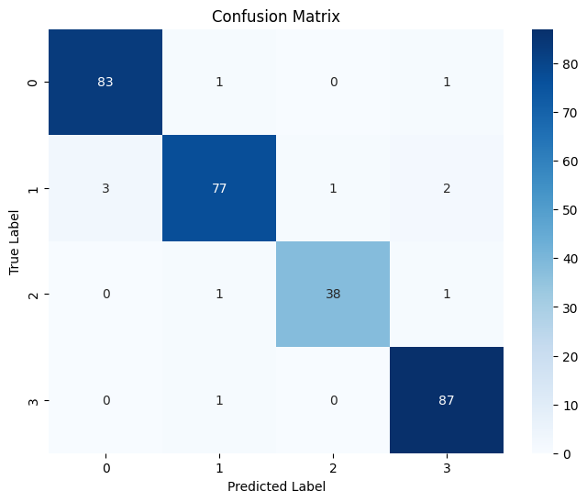
Results
2. VGG19

Slide 15

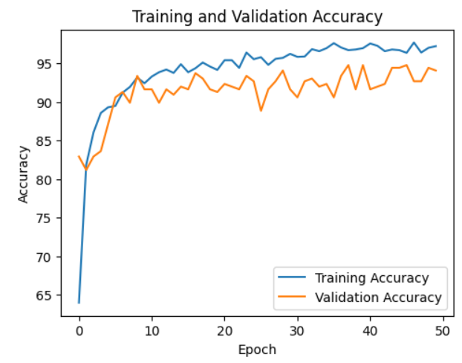
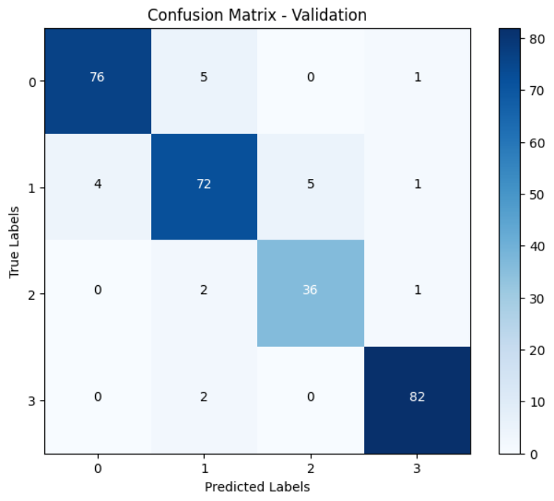
Results
3. Resnet

Slide 16

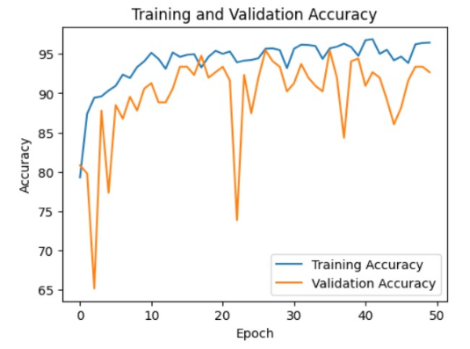

Results
4. EfficientNet

Slide 17
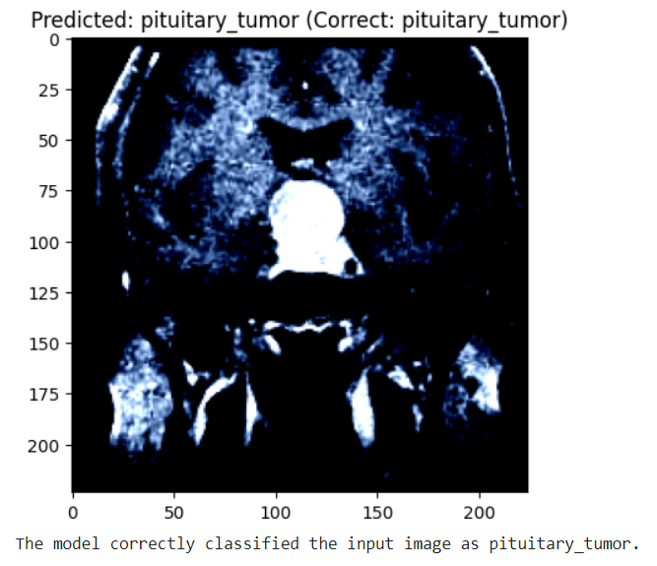
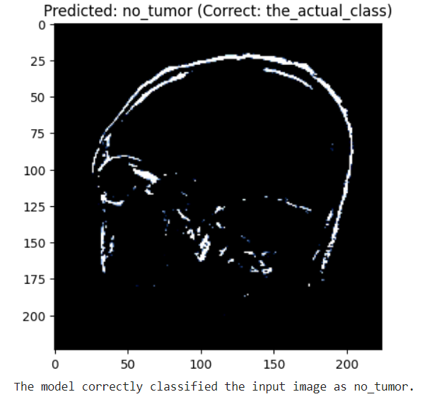
Results
Image classification using Multi bit planes and Mask RCNN

Slide 18
Conclusions and Future Scope
Successful exploration of medical image classification using various deep learning approaches.
Effective tumor categorization demonstrated by the help of Mask RCNN.
Involves the potential of deep learning to improve diagnostic accuracy in medical imaging.
Datasets can expanded to include more diverse types, which improves model generalizability and real-world application.
Advanced techniques, such as transfer learning, can be integrated to make more robust predictions.

Slide 19
References
Nguyen, Tuan & Arch-int, Somjit & Arch-int, Ngamnij. (2015). An adaptive multi bit-plane image steganography using block data-hiding. Multimedia Tools and Applications. 75. 1-27. 10.1007/s11042-015-2752-9.
Rizzi, M.; Guaragnella, C. Skin Lesion Segmentation Using Image Bit-Plane Multilayer Approach. Appl. Sci. 2020, 10, 3045. https://doi.org/10.3390/app10093045.
K. H. Rhee, "Forensic Detection Using Bit-Planes Slicing of Median Filtering Image," in IEEE Access, vol. 7, pp. 92586-92597, 2019, doi: 10.1109/ACCESS.2019.2927540.

Slide 20
References
Brain Tumor Image Segmentation in MRI Image Hapsari Peni Agustin Cahyaningtyas .
Brain Tumor Classification Using Texture Feature Extraction- Journal of Physics: Conference Series
Brain Tumor Detection Based on Features Extracted and Classified Using a Low-Complexity Neural Network Article in Traitement du Signal · July 2021
Automatic brain tumor detection and classification on MRI images using machine learning techniques. A report submitted in partial fulfillment of the requirements for the degree Engineering

Slide 21
Thank you

